Slide 1

University of Montemorelos
Faculty of Business and Law
PhD in Business Administration
Predictive Factors of Financial Satisfaction of the Members of the Seventh-day Adventist Churches in Edmonton Alberta.
By
Reynold A. Ferary

Slide 2
Research Question
How does financial literacy, financial attitude, financial behavior and financial indebtedness, predict financial satisfaction of the members of the Seventh-day Adventist churches in Edmonton Alberta?

Slide 3
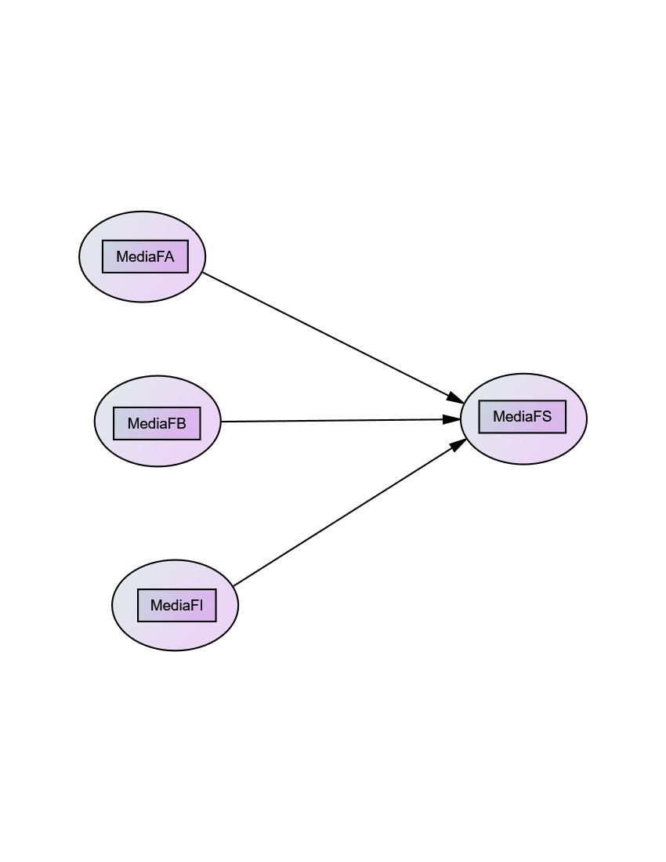
The Model

Slide 4
Hypothesis
H1. Financial literacy, financial attitude, financial behavior and financial indebtedness, predict financial satisfaction of the members of the Seventh-day Adventist churches in Edmonton Alberta.

Slide 5
Multiple Regression Assumptions:
The dataset was cleaned to ensure normality by the elimination of 43 data points leaving the dataset at 278 data points.
For this research the following criterion was analyzed:
  Linearity through the graphs.
  Test for the normality of the errors with the Kolmogorov-Smirnov statistic (p> .05), forty three atypical data were eliminated and the data is not normal.
  Independence of the errors was proved using the Durbin-Watson test, whose value is very close to 2,(the value for this regression was 2.17) this indicates that the errors are not correlated and are independent.
  The homoscedasticity was analyzed and it was proven that the errors have equal variances.

Slide 6
Null Hypothesis
H0: The empirical model, in which financial literacy, financial attitude, financial behavior, and financial indebtedness are not predictors of financial satisfaction of the members of the Seventh-day Adventist churches in Edmonton Alberta.

Slide 7
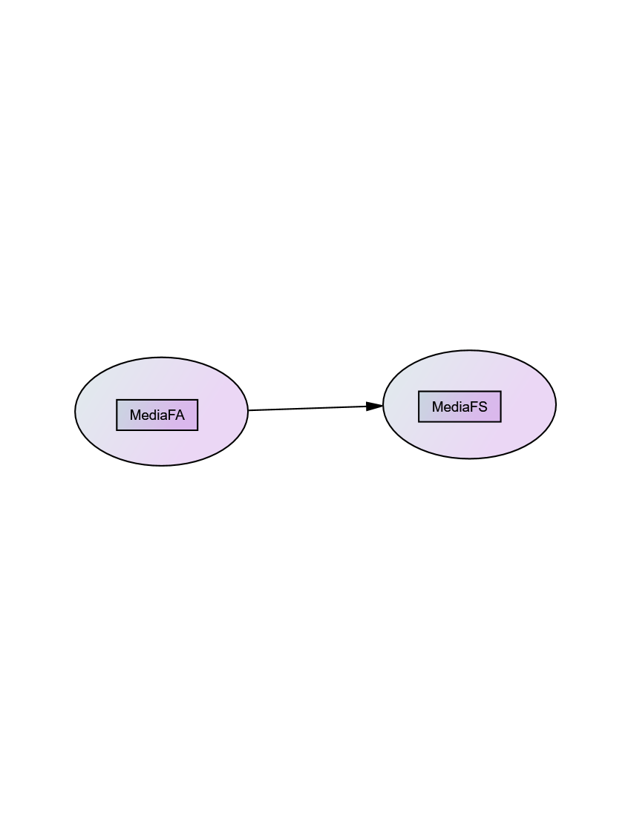
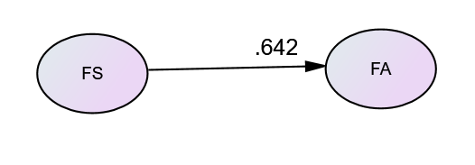
Results
By applying the method of stepwise in the regression analysis the following were observed:
Model 1:
The best predictor:
(Adj R² = .411)
F value =223.193 and p value =.000.
As it can be observed that the p value is less than .05, therefore, there is a positive and significant lineal correlation. Thus, the null hypothesis is rejected.

Slide 8
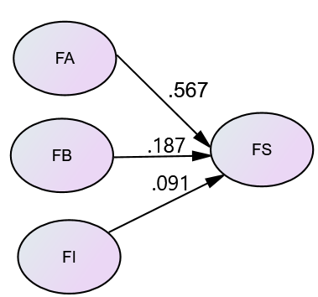
Results
Model 2:
The best model: Financial attitude, financial behavior and financial indebtedness predict on financial satisfaction (44.6%)
F value =86.77 and p value =.000.
As it can be observed that the p value is less than .05, therefore, there is a positive and significant lineal correlation. Thus, the null hypothesis is rejected.

Slide 9
Results
Model 1:
financial satisfaction = 2.074 +.585(FA)
Model 2:
financial satisfaction= .750 +.516(FA)
+ .223(FB)
+ .104(FB)

Slide 10
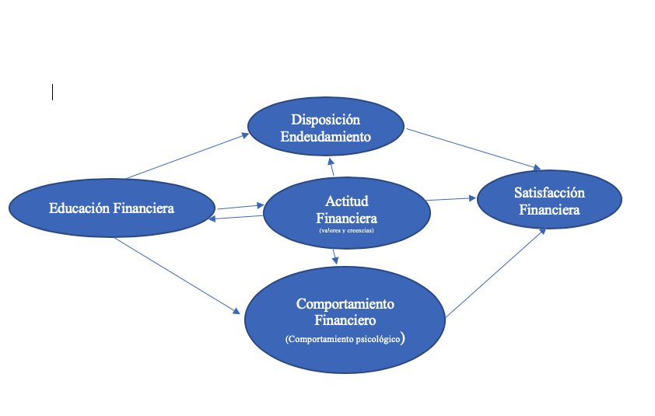
The Model

Slide 11
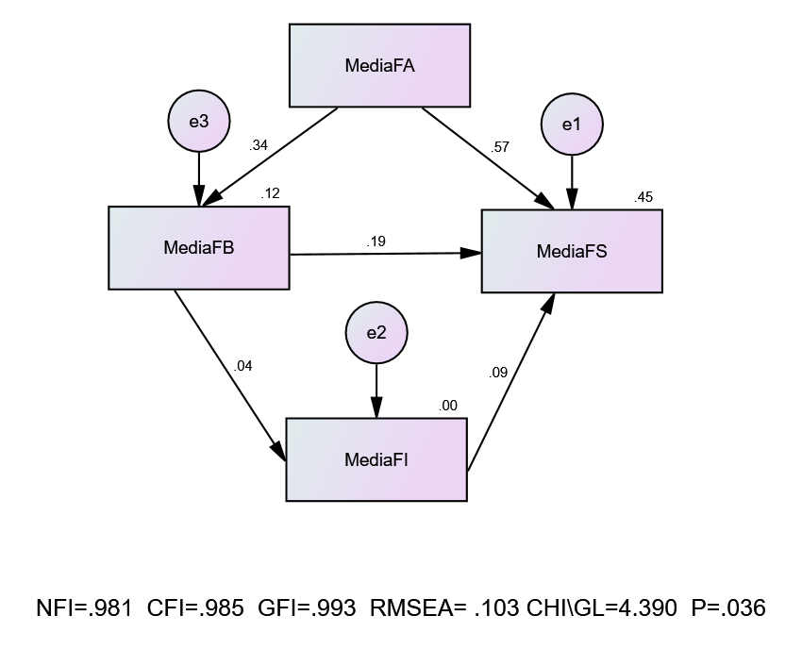
Structural Equation

Slide 12
The End:
Thank You!

