Slide 1




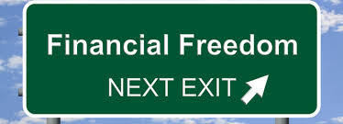
How to get out of Debt
By: Pastor Reynold Ferary

Slide 2
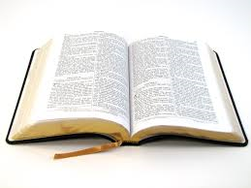
Proverbs 22:7
“The rich rule over the poor, and the borrower is servant to the lender.”

Slide 3
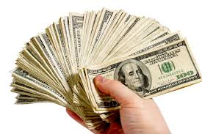
“In this materialistic, money –oriented society, men and women place high priority on possessions, earning power and lifestyle.” “It’s your money” G.E.Reid P.41
Proverbs tells us that debt is slavery.
“… today it seems that Satan inspired such a high level of debt to tie up God’s people and hinder the cause of God as a result.”
“It’s your money” G. E. Reid P.56

Slide 4
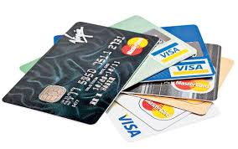
According to Jean Chatzky:
The average American family is now carrying between 8,000.000 and 9000.000 in credit card debt alone. We owe more on our homes, cars and education than any previous generation.

Slide 5


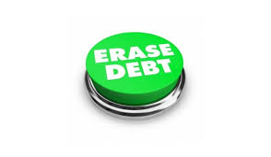
How to Eliminate Debt?
There are two different methods of debt repayment:

Slide 6

1. The Interest Rate Method.

Slide 7

2. The Snowball Method

Slide 8
The Snowball Method

Slide 9

Debt Reduction/Elimination Model

Slide 10


Lifestyle Changes:
• Reduce Expenses
• Avoid new debt
• Increase income
• Operate on a budget
• Have a repayment plan

Slide 11
Even with good intentions debt can become unmanageable over time. Everyone’s debt situation is different, which means every client needs a unique and customized approach to debt elimination.

Slide 12

Why does the Bible talk so much about debt?
• Debt is deceitful.
• Debt is enslaving.
• Debt may deny God the opportunity of working on our behalf.

Slide 13
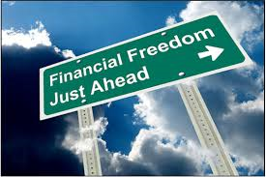


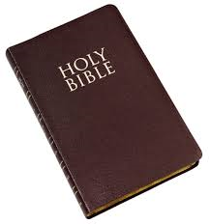
Essential Elements for Financial Freedom:
1.Communication/working together
2. Set goals
-Vision
3. Understand debt
4.Education/books/seminars/personal experience
5. Work the debt elimination triangle
6. Budgeting
7. Taxes/ points credit card
8. Prepayment policy and penalty?
9. Debt consolidation (OPM) (Refinancing)
10. Compound and simple Interests
11. Line of credit-closed/opened
12. Follow God’s Plan

Slide 14
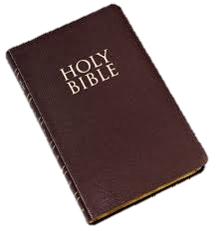
Malachi 3:8-10
8 “Will a man rob God? Yet ye have robbed me. But ye say, Wherein have we robbed thee? In tithes and offerings.”
9 “Ye are cursed with a curse: for ye have robbed me, even this whole nation.”
10 “Bring ye all the tithes into the storehouse, that there may be meat in mine house, and prove me now herewith, saith the Lord of hosts, if I will not open you the windows of heaven, and pour you out a blessing, that there shall not be room enough to receive it.”

Slide 15
Mortgage Repayment
“Nothing you will ever do in your lifetime is likely to make you as much money as buying a house and living in it.” “The Automatic Millionaire Home-Owner” David Bach P. 5
How Does an Amortization Schedule Work?

Slide 16


Pass It On!
“We could compare passing our faith and experience on to the next generation to a relay race. Any track coach will tell you that relay races are won or lost in the transferring of the baton from one runner to another. Seldom do sprinting athletes drop the baton once they have it firmly in their grasp. Losing usually happens during the exchange between runners.” “It’s your Money” G. E. Reid Pgs. 81, 82

