Slide 1







Family finance 101
By: Pastor Reynold Ferary

Slide 2

Definition of family
"A social unit of two or more persons related by blood, marriage, or adoption and having a shared commitment to the mutual relationships.

Slide 3

What is money?
The greatest block to a full understanding of stewardship is money.
To the average minds, stewardship and money are synonymous. This is due to the fact that the teaching, writing, and preaching on the subject of stewardship relates to money and/ or material things.

Slide 4

What is money?
Time + Talent = Life
Time + Talent = Money
Money = Life

Slide 5
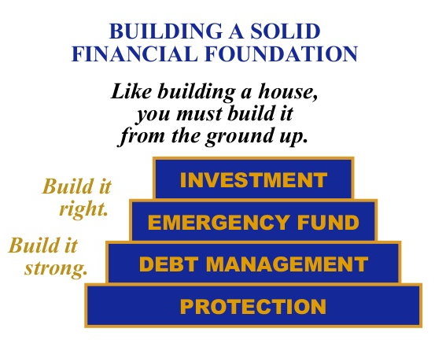
Financial foundation
Just like when you build a house, you start with laying down a solid Financial Foundation.
* Investment
* Emergency Fund
* Debt Management
* Protection

Slide 6
Financial foundation
* Have a proper protection in the event of disability.
* Reduce your liability and get out of debt.
* Set aside 3-6 months of operating expenses to deal with emergencies.
* Save and invest for future

Slide 7
Definition of stewardship
1. "The lifestyle of one who accepts Christ's Lordship by walking in partnership with God and acting as His agent to manage His affairs on earth."
2. "It is God's order for man's relationship to God, not man's order to an organization"(Wes Wilner)
3, "It is the practice of systematic and proportionate giving of Time, Talent and Material Possessions based upon the conviction that these are a trust from God to be used on the services and benefit of mankind, in grateful acknowledgement of Christ redeeming love." James L. Lewis

Slide 8
stewardship
"Stewardship and Money are not synonymous: Stewardship is a relationship, as well as management. Money, or material things, are the mutual result of this management." "Biblical Principles for Giving and Living" Mel Rees P. 28

Slide 9
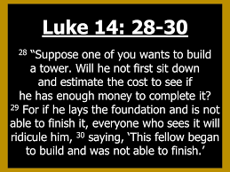



Slide 10



Visioning and budgeting are essential for successful Financial Management.

Slide 11



The roommate syndrome
Husband and wife living as roommates, where they share the costs and duties involved in running the house.

Slide 12


The Four Transcendent Planning Principles of Financial Success:
* Spend less than you earn
* Avoid the use of debt
* Maintain liquidity (or emergency savings)
* Set long-term goals
"Faith-Based Family Finances" P. 32 Ron Blue...

Slide 13


Create a road map for your family
* Mission
* Vision
* Objectives
* Goals
_ Short-term
_ Long Term
* Evaluation

Slide 14
Mission - What is our purpose? Vision - Where do we want to go? Objectives - What do we want to achieve? Goals - When do we want to achieve it? Evaluation - How are we doing?

Slide 15



Couples must work together to establish ONE Financial System!!

Slide 16
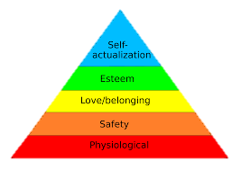
Abraham Maslow's Hierarchy of Human Needs:
1. Physiological Needs
2. Safety Needs
3. Love and Belonging Needs
4. Esteem Needs
5. Self actualization Needs

Slide 17
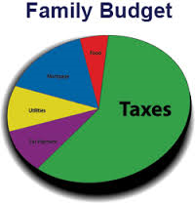
The Importance of Having a Family Budget:
* Define your financial goals
* Plan your budget together
* Always put God first in your budgeting

Slide 18
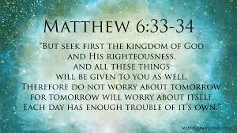

Slide 19
"Budgeting is necessary to accomplish your financial goals. If you do not budget, chances are that you are just living from pay period to pay period and on the verge of financial disaster." It's your money" P. 74 G.E. Reid

Slide 20
Seven steps to effective Financial Management:
1. Prayerfully seek God's direction regarding your lifestyle ( Prov. 3:5,6 ).
2. Learn to be content ( Phil. 4:11 ).
3. Learn to avoid coveting ( Ex. 20:17 ).
4. Do not determine your lifestyle by comparing it with others ( 1Jn. 2: 15-17 ).
5. Freely enjoy whatever you spend in the "Spirit." ( 1Tim. 4:4 ).
6. Make an effort to live more simply ( 1 Thess. 4:11, 12 ).
7. Do not be conformed to this world ( Rom. 12:2 )
"Faith-Based Family Finances" PP. 39, 40 Ron Blue

