Slide 1
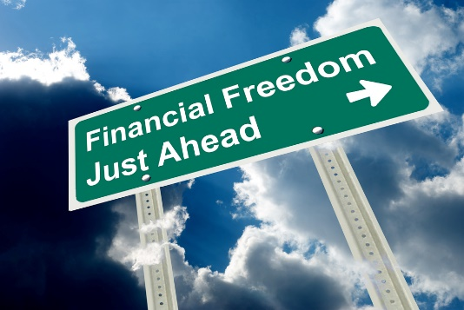

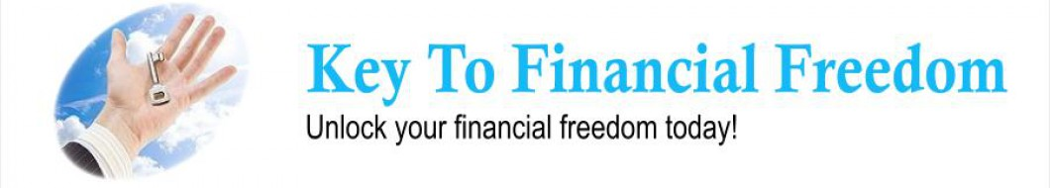
Five Keys to Financial Freedom
The Week at a glance:
Monday: Understanding the Biblical Concept of Stewardship
Tuesday: How Do We View Money?
Wednesday: Understanding the Canadian Financial System
Thursday: Visioning and Budgeting
Friday: How to Get Out of Debt

Slide 2

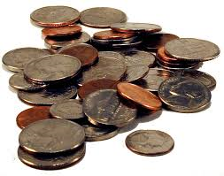

Understanding the Biblical Concept of Stewardship
By: Pastor Reynold Ferary

Slide 3


The "Five Keys to Financial Freedom" Stewardship Seminar series will help you develop financial priorities, understand money and how the Canadian financial system can work for you. These informative and biblically based presentations are designed to help you lay out a roadmap to successfully achieve your financial goals through sound fiscal visioning and budgeting, and by providing well-tested strategies for getting out of debt. All who attend the seminars will leave with a clear picture of God's plan for financial freedom, economic security, and peace of mind.

Slide 4
Legal Disclaimer
This seminar is intended for information only. Please note that I am not presenting this information as a professional in the field. The examples and calculations are not precise; rather, they are used for illustrative purposes. Pastor R. Ferary, nor the Alberta Conference, of Seventh-day Adventist, do not take any responsibility for the use of any information that is presented in this seminar.

Slide 5

Stewardship Defined
1.“The lifestyle of one who accepts Christ’s Lordship by walking in partnership with God and acting as his agent to manage his affairs on earth.”
2.“It is God’s order for man’s relationship to God, not man’s order to an organization.” (Wes Wilner)
3.“It is the practice of systematic and proportionate giving of time, talent and material possessions, based upon the conviction that these are a trust from God to be used on the services and benefit of mankind, in grateful acknowledgement of Christ redeeming love. James L. Lewis

Slide 6
Biblical Presuppositions
1. God is intimately involved in the lives of His people, individually and corporately. Scripture is the story of God relating to humanity.
2. God is ultimately in control, guiding the affairs of this world. He is directly involved in history and works through human agents to accomplish His Will (Rom. 13:1-6).
3. God is owner of all, for He is our Creator and Redeemer. As Owner, He provides for all our needs (Ps. 50:7-15; Phil.4:19).
4. God is head of His church, in direct control yet allowing room for human decisions. This factor is held in tension by the poles God’s sovereignty and human free will (Eph.1:22).

Slide 7
Biblical Presuppositions
5. God is the provider, giving everything needed to accomplish His will, in His time frame, for His church (Phil. 4:19).
6. God is in partnership with human agents to accomplish His will (Phil.2:12, 13).
7. Christ is Lord of all, and Lordship is a choice of the will (Matt. 7:21-23; Phil. 2:9-11).
8. The Holy Spirit is the active Lordship agent, and brings the living presence of Christ into the believer’s life (John 14:22-26).
9. We receive the Holy Spirit by Faith (Gal. 3:14).
10. In Christ we are able to do anything He asks us to do (Phil.4:13).

Slide 8
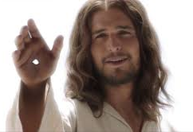
The Biblical Purposes of Stewardship
1. To glorify God
2. To accomplish God’s purpose
3. To be a part of His mission
4. To disciple His members
5. To found His kingdom

Slide 9
Implications of Stewardship
1. All life is a trust from God.
2. Any proper response to God’s ownership is powered by the Holy Spirit.
3. I am required to be a responsible manager.
4. Each Christian should dedicate a worthy portion of their time, abilities and money for the advancement of Christ’s mission in the world through His church.

Slide 10
12 Defining principles of stewardship
4. Spirituality occurs when I realize the Lordship of Jesus Christ in my life. (a) Key- Will I allow Christ to not only save me, but to transform me so that I submit my life to Him.
5. A disciple is one who walks with, learns from and lives in submission to a master in order to become the master. It is a lifelong apprenticeship (Macchia- the healthy Disciple).
6. Tithe is a test of loyalty- recognizing the ownership of God in our lives.
1. Stewardship is partnership with God- working with Him, not for Him.
2. The gospel (God’s solution to the sin problem) serves as the foundation and primary content of stewardship.
3. People must experience the gospel before they can be stewards. (a) Faith is not seeking a transaction but a transformation.

Slide 11
12 Defining principles of stewardship
7. Offerings are a test of attitude- responding to God’s blessings and the integration of God’s partnership into the material side of life.
8. The goal of stewardship must be developing spiritual maturity- raising money or managing money should be secondary.
(a) Spiritual maturity- doing the right thing at the right time for the right reason.
(b) Stewardship is a journey in the spiritual maturity of each member.
1. Promotion of equal sacrifice, and equal compassion rather than equal giving.
(c) Stewardship works as a process not as a product or an event.
9. Worship is the natural response to the Lordship of Christ. It celebrates God’s rightful place in our lives.
10. Stewardship focuses upon our seeing Jesus as He is, so that we may because transformed to be as he is.
11. Giving is about worshipping God, not about funding the church.
12. The primary motivating force in biblical stewardship is the Holy Spirit.

Slide 12
Stewardship is the Culmination of the following purposes of the church working in a healthy manner.
a. Exalting God in worship.
b. Evangelizing the world- locally and around the world.
c. Equip believers through teaching and mentoring
d. Edify others through ministry and service.
e. Encounter God in prayer.
f. Encourage one another in fellowship.

Slide 13
Challenges
1. 45- 55% of our membership give God leftovers or nothing at all.
2. Many desire to give, but are suffering because of financial bondage.
a. Credit card debt
b. Lack of savings
c. Managing monthly income
3. “Starvation strategies” are developed by the local church as a reaction to poor stewardship/giving.

Slide 14
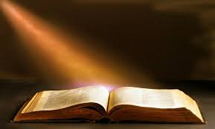
1 Corinthians 4:2
“Moreover it is required in stewards that one be found faithful.” (NKJV)

